Slide 1
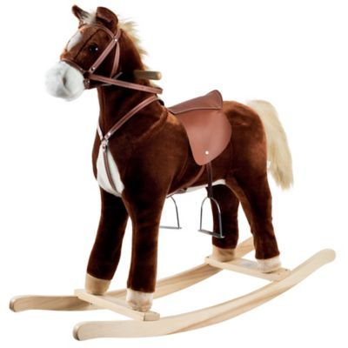
Toy Horse Conjoint Experiment
February 10, 2020
Team 4: Yueqing(Amiee) Yang, Sanket Gomase, Xueqing Hou, Ziting Liao, Meng Guo

Slide 2
Executive Summary --- Profile 4 & 16 are the final product line recommendation
Key Insights:
Benefit segmentation: Based on the cluster analysis, we choose to divide consumers into 3 clusters - Money Keeper, Rocking Kid, and Glamorous Giant (Appendix II).
Ideal product for each segment:
Money Keeper: Profile 4 (26 inches, bouncing, racing toy horse as $119.99)
Rocking Kid: Profile 14 (18 inches, rocking, glamour toy horse as $119.99)
Glamorous Giant: Profile 16 (26 inches, rocking, glamour toy horse as $119.99)
Female Preference: low price, 26 inches, rocking, glamour toy horse.
Male Preference: low price, 26 inches, bouncing, racing toy horse.
2-year-old children Preference: low price, 26 inches, rocking, glamour toy horse.
3~4-year-old children Preference: low price, 26 inches, bouncing, glamour toy horse.
Recommendation:
Product line recommendation: Producing profile 4 & profile 16.
Packaging recommendation: Packaging for profile 16 is in a girly style, and for profile 4 is in a boyish style.
Promotion recommendation: The promotion strategy should match with the preference of different groups including female children, male children, 2-year-old children, and 3~4-year-old children groups. Also, the theme of the promotion should match with the packaging theme as well.

Slide 3
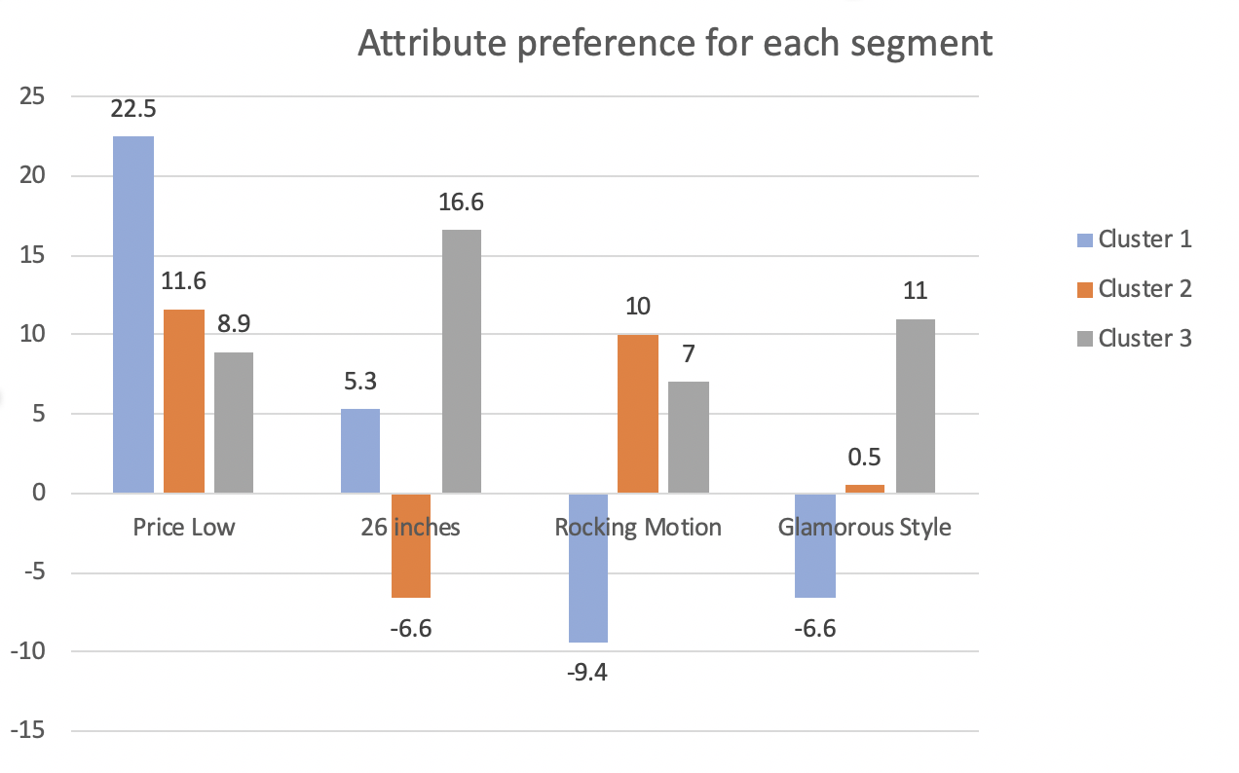
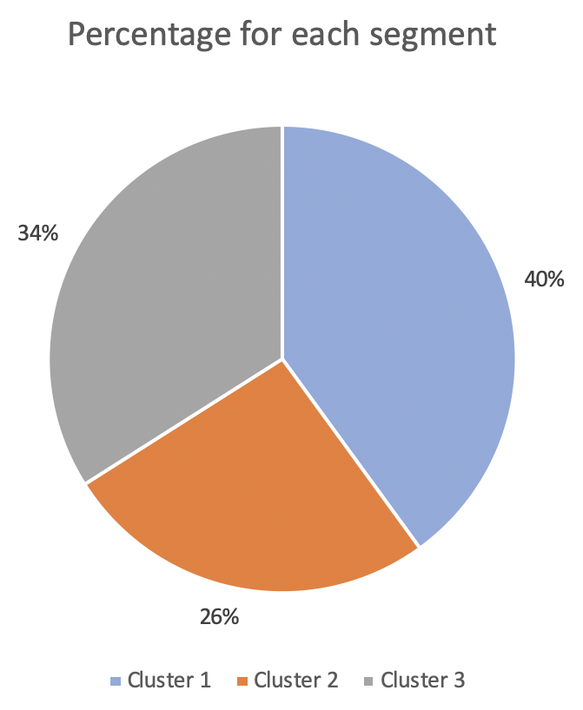
Best segmentation - 3 clusters
Cluster 1(40%) - Money Keeper: Most price sensitive group, prefer large size(26’’), bouncing motion, and racing style.
Cluster 2(26%) - Rocking Kid: Less price sensitive group, strongly prefer small size(18’’), a huge fan of rocking motion, and indifferent to the style.
Cluster 3(34%) - Glamorous Giant: Least price sensitive group, a huge fan of large size(26’’), prefer rocking motion, and strongly prefer glamour style.
(Appendix II)

Slide 4
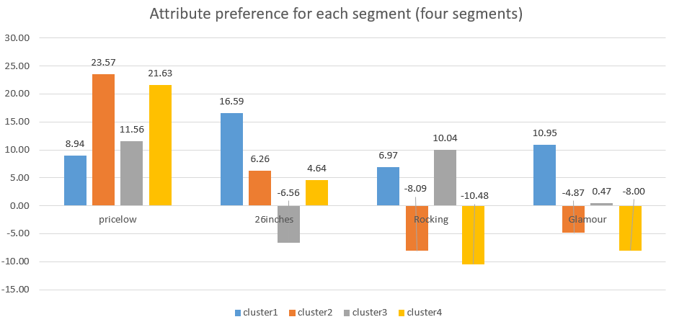
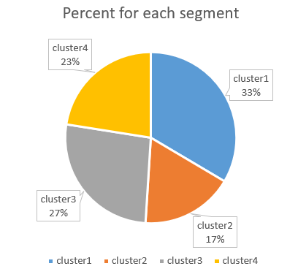
Segmentation comparison - 4 clusters
Cluster 1(33%): Least price sensitive group, strongly prefer large size(26’’), rocking motion, and glamour style.
Cluster 2(17%): Most price sensitive group, prefer large size(26’’), bouncing motion, and racing style.
Cluster 3(27%): Less price sensitive group, a huge fan of small size(18’’), prefer rocking motion, and indifferent to the toy horse style.
Cluster 4(23%): Less price sensitive group, prefer large size(26’’), a huge fan of bouncing rate and racing style toy horse.
(Appendix II)

Slide 5
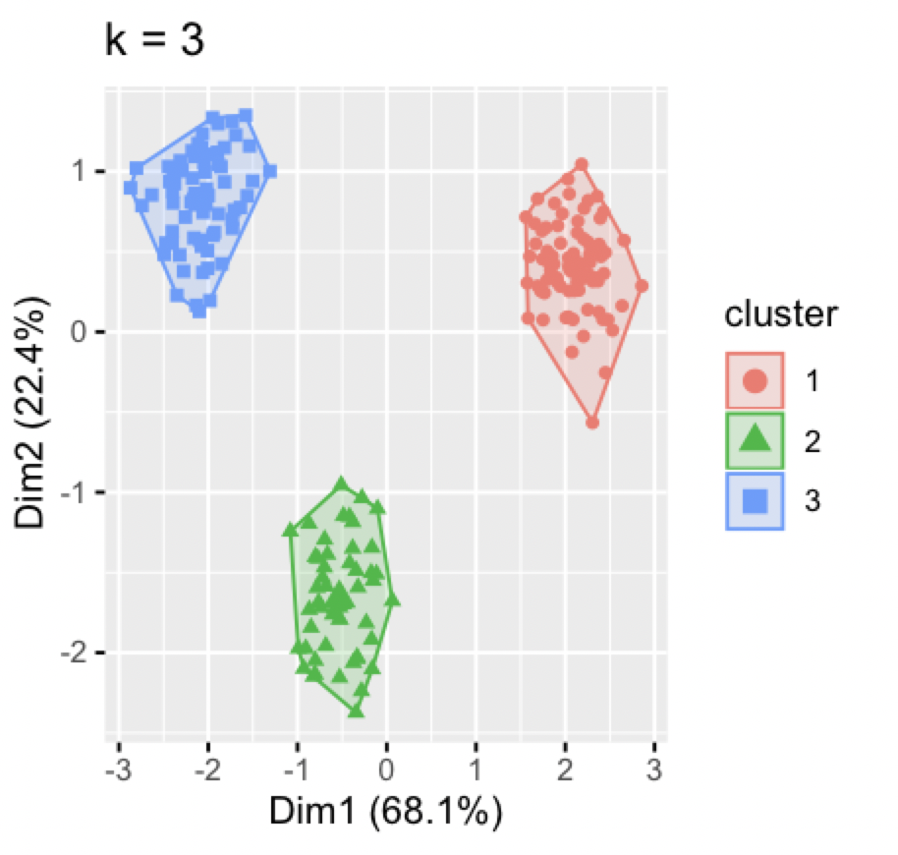
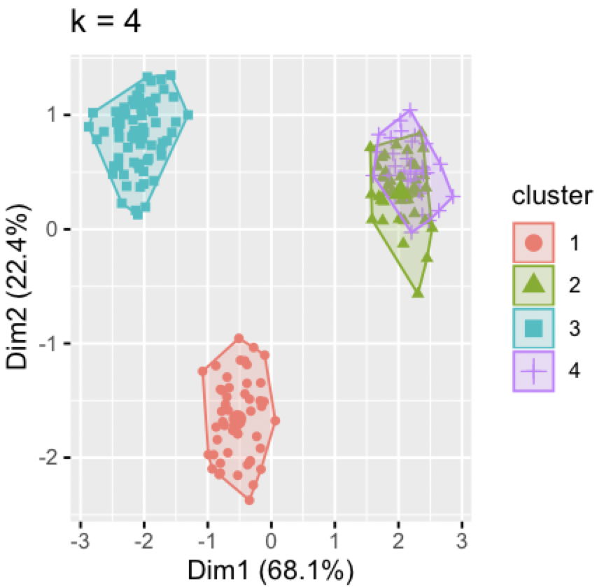
3 clusters and 4 clusters comparison: 3 clusters is better
3 clusters:
Different dimension among clusters, similar dimension within clusters.
No overlapping area among clusters.
4 clusters:
Similar dimension within clusters.
Cluster 2 and 4 have similar dimension.
Overlapping area for cluster 2 and 4.
Because cluster 2 and 4 share the similar attributes preference, it is not necessary to include these two clusters. Therefore, it is better to cluster people into three groups instead of four.

Slide 6
Profile 4, 14 & 16 are the ideal product for each cluster
Cluster 1 (Money Keeper)
Very price sensitive → $119.99
Large size → 26”
Fan of bouncing motion → Bouncing
Fan of racing style → Racing
Profile 4
Cluster 2 (Rocking Kid)
Less price sensitive, but still prefer low price→ $119.99
Fan of small size → 18”
Fan of rocking motion → Rocking
Prefer glamour style a little bit → Glamour
Profile 14
Cluster 3 (Glamorous Giant)
Least price sensitive, but still prefer low price→ $119.99
Fan of big size → 26”
Prefer rocking motion → Rocking
Fan of glamour style → Glamour
Profile 16

Slide 7
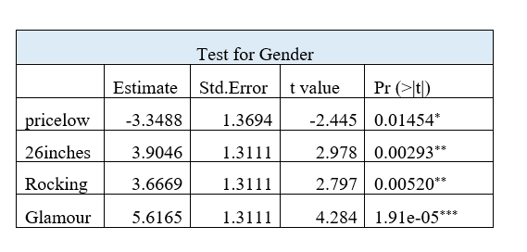
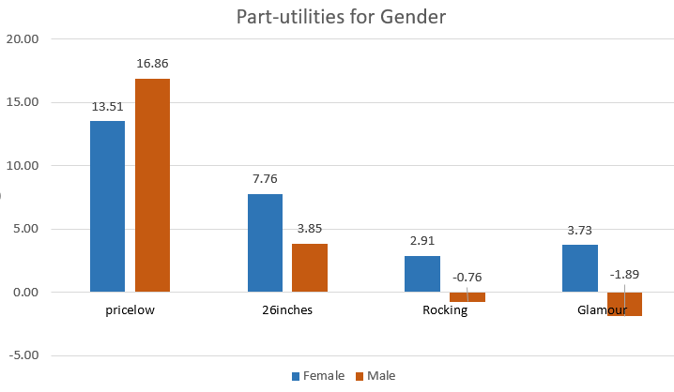
Females who are less price sensitive prefer 26 inches, rocking and glamour toy horse
Executive Summary
Executive Summary
In order to check whether children’s gender has significant influences on customer consumption choices, use regression (Appendix III) ratings~(factor(price)+factor(size)+factor(motion)+factor(style))*factor(gender) to do the test.
Female children and male children have different utilities for four attributes.
Customers having female child prefer low price, 26 inches, rocking, glamour toy horse (Ideal product: profile 16).
Customers having male child prefer low price, 26 inches, bouncing, racing toy horse (Ideal product: profile 4).
Compared to customers having male child, customers having female child are less price sensitive, and they prefer 26 inches, rocking and glamour toy horse. All these four variables are significant in t-test.

Slide 8
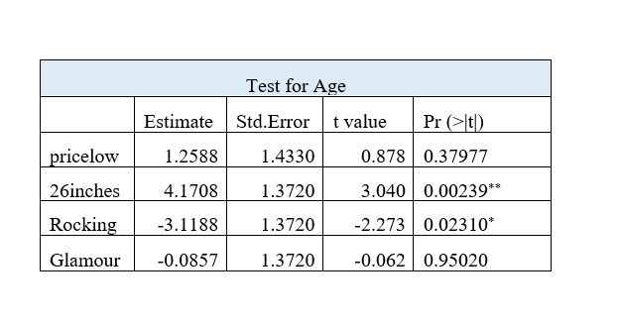
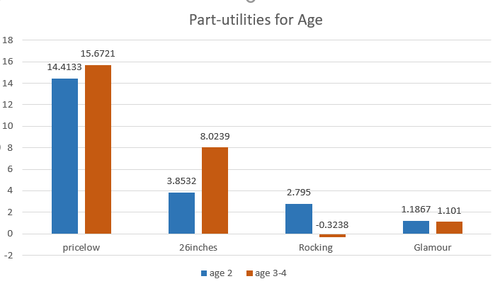
3~4-year-old children have more preference on 26 inches, bouncing toy horse
Executive Summary
Executive Summary
In order to check whether age has significant influences on customer consumption decisions, use regression (Appendix III) ratings~(factor(price)+factor(size)+factor(motion)+factor(style))*factor(age) to do the test.
Children of different ages have different utilities for four attributes.
2-year-old children prefer low price, 26 inches, rocking, glamour toy horse (Ideal product: profile 16).
3-year-old or 4-year-old children prefer low price, 26 inches, bouncing, glamour toy horse (Ideal product: profile 12).
Compared to 2-year-old children, 3-year-old or 4-year old children prefer 26 inches, bouncing toy horse. Only size and motion will influence their consumption choice.
There is no difference in the price sensitive and style preference of the children in different ages.

Slide 9
Current annual profit is $95866.24 with 43% market share.
sis with first choice r
Executive Summary
 | Profile 5 | Profile 13 | Total
Market size in 200 units | 44 | 42 | 86
Total market size | 880 | 840 | 1720
Margin profit | 78.99 | 78.99 | /
Fixed cost | 20000 | 20000 | 40000
Total profit | 49512.96 | 46353.28 | 95866.24
Market share | 22.00% | 21.00% | 43.00%
Current total profit is $95,866.24 with profile 5 & 13. Total market share is 43%.
As for profile 5, the profit is $49512.96, market share is 22%.
As for profile 13, the profit is $46353.28, market share is 21%.

Slide 10
Launching profile 4 & 16 can bring highest profit and market share
Executive Summary
After clustering the customers, we notice that profile 4, 14 & 16 are the most popular profiles among the customers, so we decide to choose 2 out of these 3 profiles to launch.
We assume that if we set the price at $139.99, when the competitor notice their market share decreases, the competitor will drop their price to $119.99; if we set the price at $119.99, the competitor will also set their price at $119.99.
 | Profile | Competitor | Changing & adding cost | Profile 4 | Profile 14 | Profile 16 | Profit without fixed cost | Profit | Market share
Scenario 1 | 4+16 | 8 | 53333.33 | 71 | 0 | 93 | 197407.2 | 144073.87 | 82.00%
Scenario 2 | 4+14 | 8 | 46666.67 | 80 | 53 | 0 | 173953.4 | 127286.73 | 66.50%
Scenario 3 | 14+16 | 8 | 46666.67 | 0 | 46 | 73 | 138236.2 | 91569.53 | 59.50%
Scenario 4 | 4+14+16 | 8 | 73333.33 | 71 | 44 | 68 | 225343.4 | 152010.07 | 91.50%
 | Profile | Competitor | Changing & adding cost | Profile 3 | Profile 13 | Profile 15 | Profit without fixed cost | Profit | Market share
Scenario 5 | 3+15 | 7 | 53333.33 | 77 | 0 | 89 | 254166.8 | 200833.47 | 83.00%
Scenario 6 | 3+13 | 7 | 46666.67 | 83 | 62 | 0 | 235711 | 189044.33 | 72.50%
Scenario 7 | 13+15 | 7 | 46666.67 | 0 | 42 | 78 | 177096 | 130429.33 | 60.00%
Scenario 8 | 3+13+15 | 7 | 73333.33 | 77 | 42 | 69 | 292122.4 | 218789.07 | 94.00%
(Appendix IV)

Slide 11
Launching profile 4 & 16 can bring the highest and stable profit
Executive Summary
Launching profile 3- 26 inches bouncing racing horse at $119.99, profile 13- 18 inches rocking glamour horse at 119.99 & profile 15-26 inches rocking glamour horse at 119.99, the company can bring our company highest market share 94% and the largest profit $200833
However, if we produce three products, the retailer will not choose all these three products to sell. Since the retailer can only sell 2-3 products in the market, and our market share is 94% instead of 100%, the retailer may sell competitor’s product, as a result, our market share will decrease and profit is decrease, so launching profile 3, 13 & 15 is not a good choice.
Launching profile 3- 26 inches bouncing racing horse at $139.99 and profile 15-26 inches rocking glamour horse at 139.99 can bring our company second highest market share 83% and the second largest profit $200833
However, if we set our size at $139.99 and our market share will reach 83%, the competitor will notice that their product is not popular and they will decrease their price, all the customers in the market prefer low price product, as a result, we will lose some market share, so launching profile 3 & 15 is not a good choice.
Launching profile 4- 26 inches bouncing racing horse at $119.99 and profile 16-26 inches rocking glamour horse at $119.99 can bring our company $144073 profit, and the company market share will reach 82%.

Slide 12
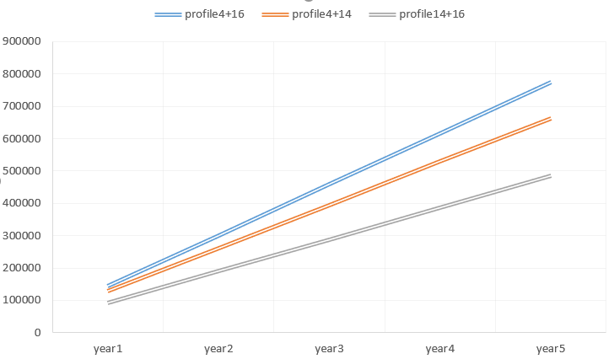
Launching profile 4 & 16 for long term
Executive Summary
Long term profit for different scenarios
From the second year, the company does not need to pay extra money for switching product types. The fix cost drop to $40,000 per year, as a result , and the profit will increase to $157407.2 per year.
Within 5 years, profile 4 and profile 16 will bring the highest profit for company. Total profit is $737702.67

Slide 13




Further recommendations
Executive Summary
Profile 16 (customers having baby girl preferred)
Packaging: The total packaging should be in a girly style
With girly colors such as pink, light red, light purple…
Use soft textile as the package such as tulle fabric or lace fabric
With some girly patterns as decoration such as heart or star
Messaging: Talking in a melting way; adding a sentence like “Sit on this most comfortable toy horse, be the most beautiful princess.”
Profile 4 (customers having baby boy preferred)
Packaging: The total packaging should be in a boyish style
With boyish colors such as blue, grey, brown…
Use hard material as the package such as hardboard box
With some masculine patterns as decoration such as horse
Messaging: Talking in a energetic way; adding a sentence like “Ride on this most dynamic “real horse”, be the most heroic warrior.”
According to the age analysis, 3-year-old children like profile 12 very much, but it is not in our current recommendation set. In the future, if the company want to expand their product set, they can take profile 12 into consideration to attract that niche market.

Slide 14
Appendix

Slide 15
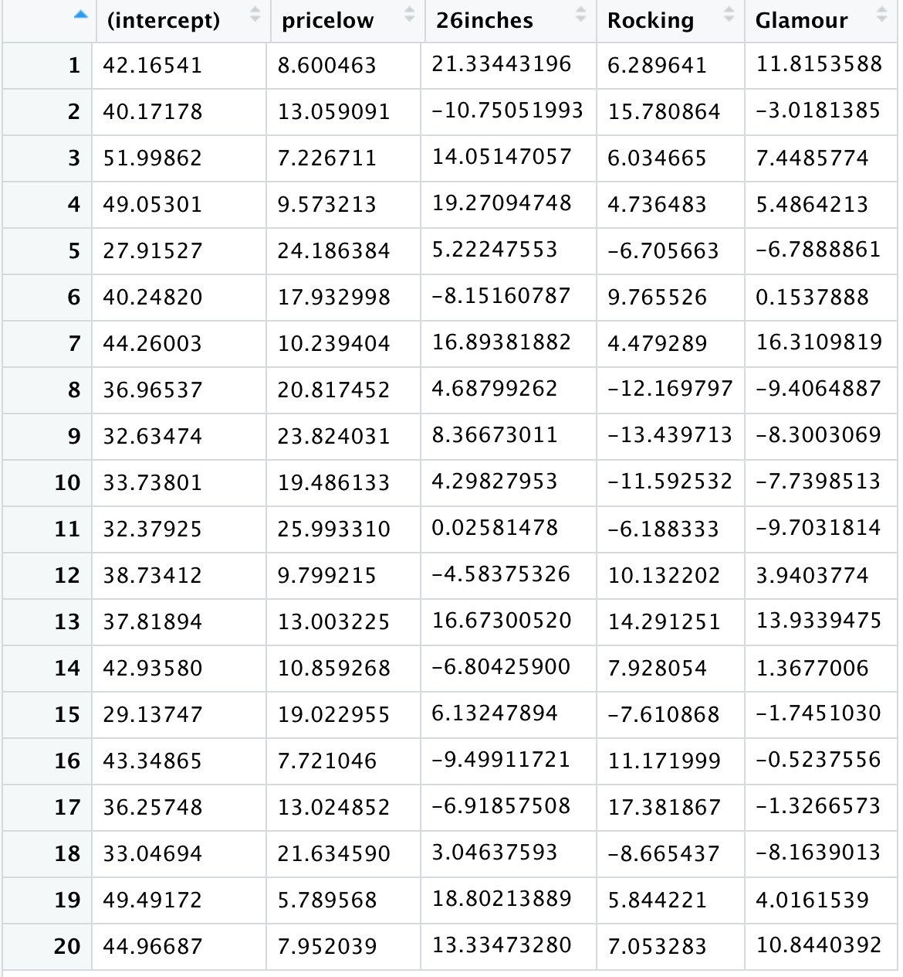
Executive Summary
Appendix I: Portion of part-utilities of individual level regression (head = 20)

Slide 16
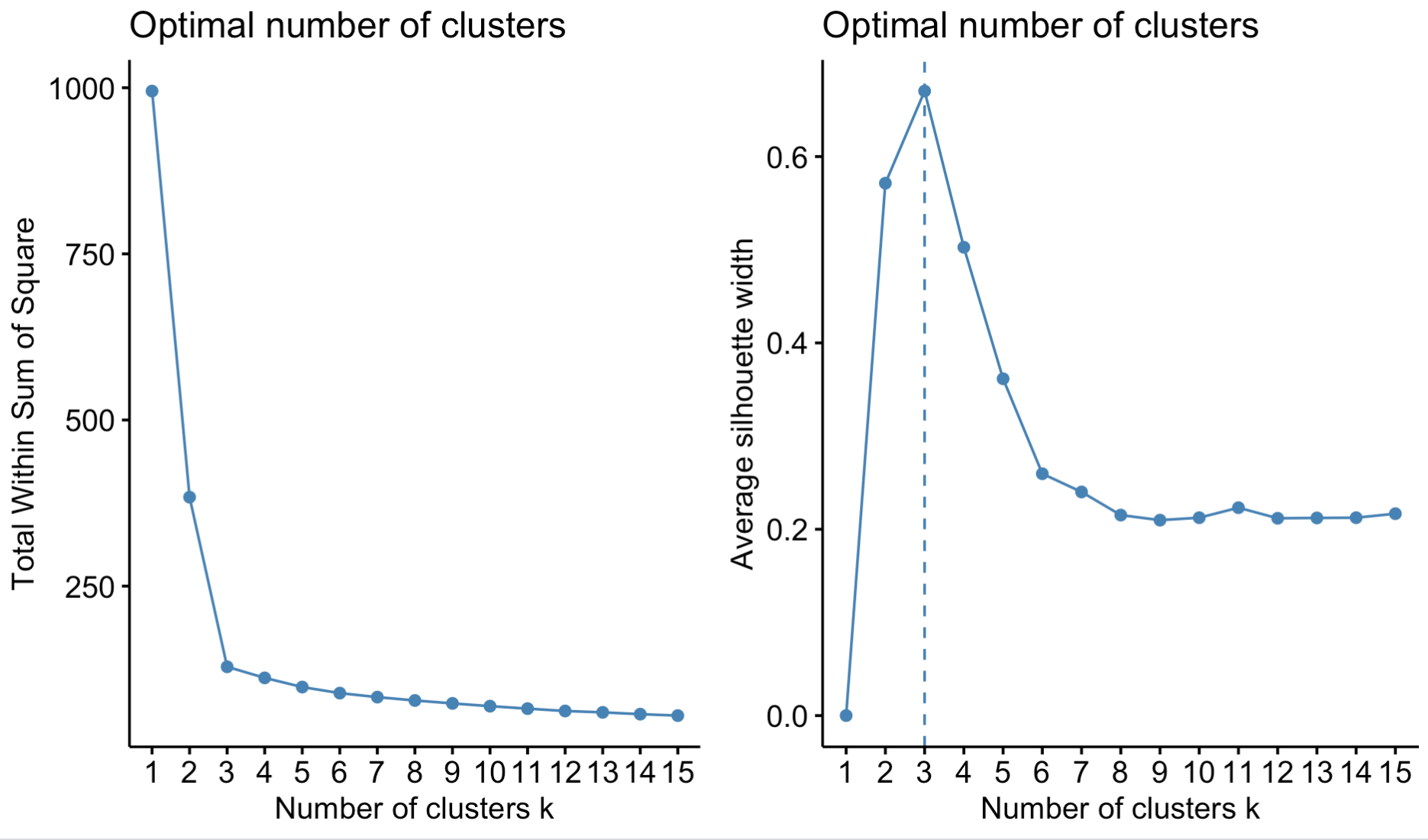
Executive Summary
Appendix II: Choose number of segments - 3 clusters are best segmentation choice
Strong elbow pattern. Number of clusters for the best segmentation should be 3 clusters.
Focal points at 3.

Slide 17
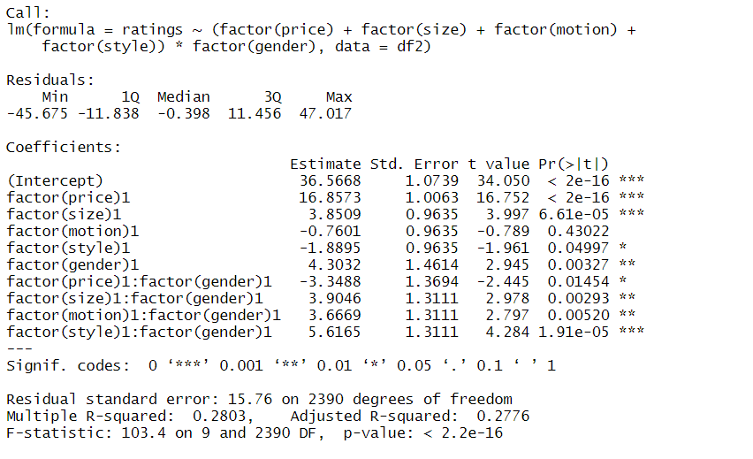
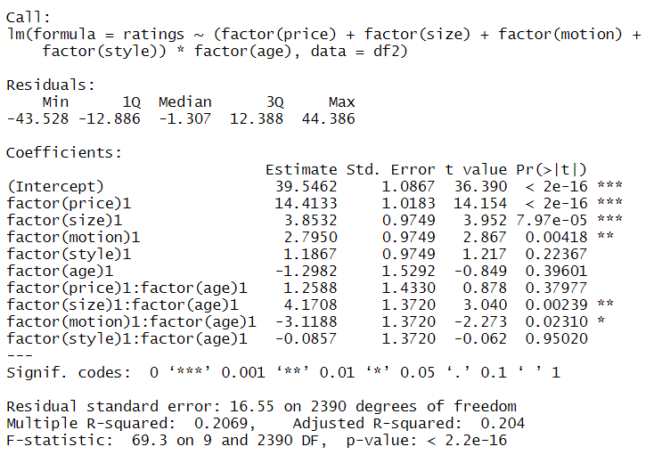
Executive Summary
Appendix III :Regression result for gender and age test
Gender part-utilities test
Age part-utilities test
Executive Summary

Slide 18
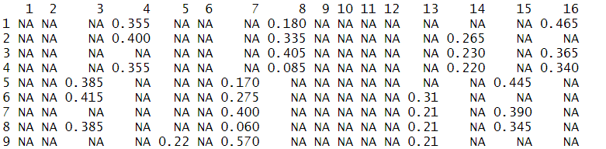
Executive Summary
Appendix IV:Use rankings to calculate market share
Market share in different scenarios

